Slide 1
System Design

Slide 2
What is System Design?
Process of defining the architecture, interfaces, and data for a system that satisfies specific requirements.
Meets the needs of our business or organization through coherent and efficient systems.
Once we get requirements of our system, next step is to translate it into technical specifications, so we can start constructing.
Notes:
Systems design is the process of defining the architecture, interfaces, and data for a system that satisfies particular requirements. System design should satisfy specific needs of a business or organization through a coherent, well-running system.
After you have your requirements, you examine and transform them into a physical system design that addresses the customers’ needs. The design activity will vary depending on if you go for custom development, commercial solutions, or a combination of both.
Systems design requires a systematic approach to building and engineering a system. A good system design requires engineers to think about everything in an infrastructure, from the hardware/software, down to the data and how it’s stored.

Slide 3
System Design: Design Methods
Design methods are
Architectural design: describes the views, models, behavior, and infrastructure of a system.
Logical design: represents the data flow and inputs/outputs of a system.
Physical design: includes how users can add information, how a system represents information to users, and how data is modeled/stored.

Slide 4
System Design: Kinds of System
Horizontally Scaled
Vertically Scaled
Monolithic Applications
Microservices

Slide 5
Design Methods
Design methods to satisfy our system’s requirements for :
Scalability
Reliability
Security
Performance
Consistency
Notes:
There are different methods you can use to satisfy your system’s requirements for scalability, reliability, security, performance, and consistency.

Slide 6
Scalable System
Refers to application’s ability to handle and withstand an increased workload without sacrificing latency.
Two ways to scale an application :
Horizontally
Vertically
Notes:
Scalability refers to an application’s ability to handle and withstand an increased workload without sacrificing latency. An application needs solid computing power to scale well. The servers should be powerful enough to handle increased traffic loads. There are two main ways to scale an application: horizontally and vertically.

Slide 7
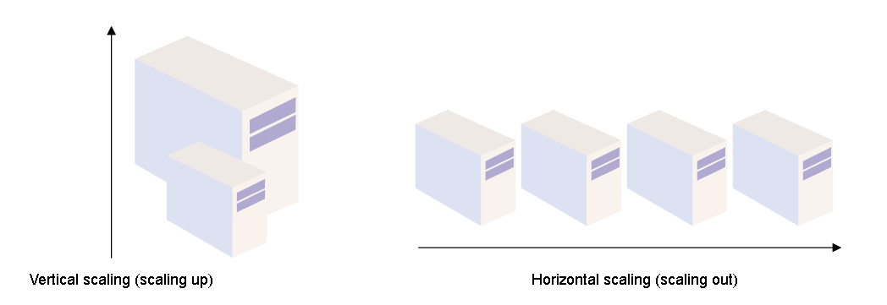
Scalable System
Horizontal Scaling
- Adding more hardware to the existing hardware resource pool.
- Increases the computation power of the system as a whole
Vertical Scaling
-Adding more power to our server.
-Increases the power of the hardware running the application.
Notes:
Horizontal scaling, or scaling out, means adding more hardware to the existing hardware resource pool. It increases the computational power of the system as a whole.
In horizontal scaling, we add more machines in parallel to deal with the increasing requirements. We will need load balancing to distribute the load across the system.
If any machine fails, the requests are redirected to the other machines, and it scales well when our users increase. Data inconsistency is a drawback.
Vertical scaling, or scaling up, means adding more power to your server. It increases the power of the hardware running the application.
Vertical scaling uses one huge machine that handles all our requests and improves response time and throughput. Though it offers faster network calls, data consistency, and no load balancing, we have a single point of failure and hardware limitations.

Slide 8
Monolithic Applications
Single Tiered applications
Not Complex
Have no duplication
Faster procedure calls
Notes:
These are single tiered applications with different components from a single platform. These are good for small teams as they are not complex, have no duplication, and have faster procedure calls. Despite that, they can be difficult to maintain if they get too large or complex.

Slide 9
Microservices
An architectural style that structures an application using loosely coupled services.
Divides a large application into a collection of separate, modular services.
Modules can be independently developed, deployed, and maintained.
Notes:
Microservices operate at a much faster and more reliable speed than traditional monolithic applications.
Since the application is broken down into independent services, every service has its own logic and codebase.
These services can communicate with one another through Application Programming Interfaces (APIs).
Microservices are ideal if we want to develop a more scalable application.
With microservices, it’s much easier to scale our applications because of their modern capabilities and modules.
If we work with a large or growing organization, microservices are great for our team because they’re easier to scale and customize over time.

Slide 10
Other Fundamentals of System Design
Proxy servers
Acts as a channel between a user and the internet
Separates the end-user from the website they’re browsing.
Not only forward user requests but also provide many benefits, such as:
Improved security
Improved privacy
Access to blocked resources
Control of the internet
usage of employees and children
Cache data to speed up requests
Proxy Server or Forward Proxy
App Server
request
request
Client
response
response
Notes:
Whenever a user sends a request for an address from the end server, the traffic flows through a proxy server on its way to the address. When the request comes back to the user, it flows back through the same proxy server which then forwards it to the user.

Slide 11
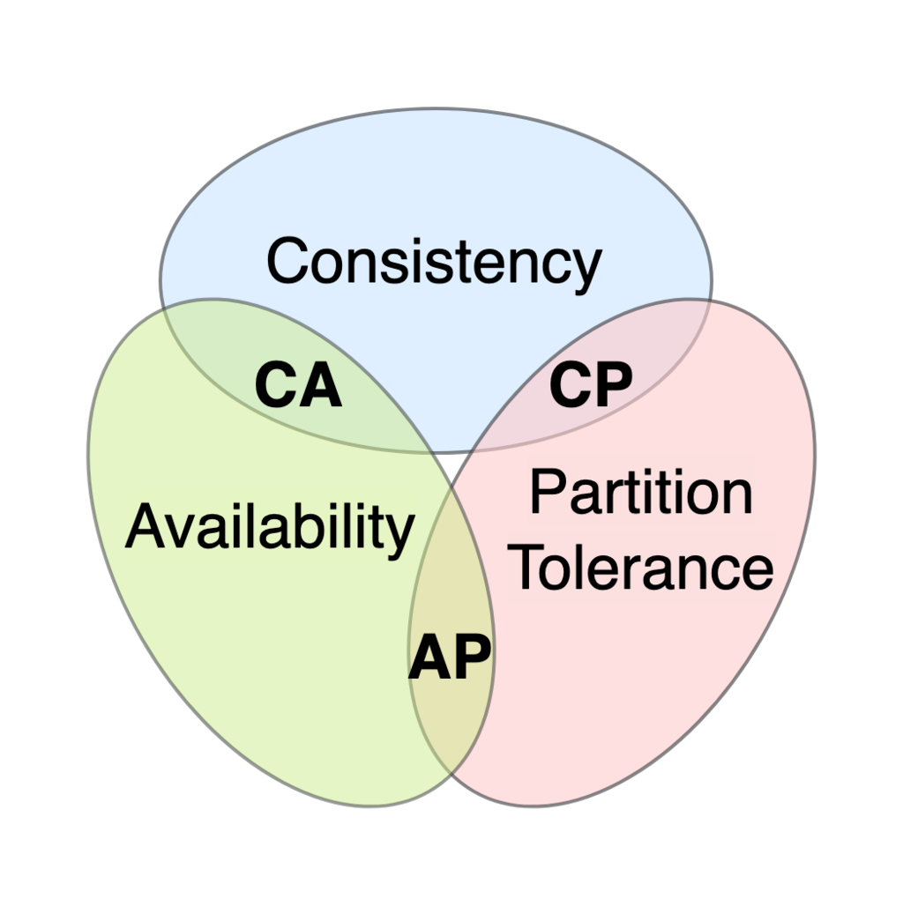
CAP theorem
A distributed system can only provide two of three properties simultaneously: consistency, availability, and partition tolerance.
Consistency
All nodes see the same data simultaneously
Availability
System remains operational all of the time
Partition tolerance
Break in communication between nodes
Further Reading : https://en.wikipedia.org/wiki/CAP_theorem
Notes:
The CAP theorem is a fundamental theorem within the field of system design. It states that a distributed system can only provide two of three properties simultaneously: consistency, availability, and partition tolerance. The theorem formalizes the tradeoff between consistency and availability when there’s a partition.
Consistency
In a consistent system, all nodes see the same data simultaneously. If we perform a read operation on a consistent system, it should return the value of the most recent write operation. The read should cause all nodes to return the same data. All users see the same data at the same time, regardless of the node they connect to. When data is written to a single node, it is then replicated across the other nodes in the system.
Availability
When availability is present in a distributed system, it means that the system remains operational all of the time. Every request will get a response regardless of the individual state of the nodes. This means that the system will operate even if there are multiple nodes down. Unlike a consistent system, there’s no guarantee that the response will be the most recent write operation.
Partition tolerance
When a distributed system encounters a partition, it means that there’s a break in communication between nodes. If a system is partition-tolerant, the system does not fail, regardless of whether messages are dropped or delayed between nodes within the system. To have partition tolerance, the system must replicate records across combinations of nodes and networks.
Data Partitioning is the technique of distributing data across multiple tables, disks, or sites in order to improve query processing performance or increase database manageability.

Slide 12
CAP theorem
NoSQL Databases are great for distributed networks.
Allows Horizontal Scaling
Which NoSql DB to use :
CA databases
Enable consistency and availability across all nodes.
Can’t deliver fault tolerance
CP databases
Enable consistency and partition tolerance, but not availability.
Turn off inconsistent nodes until the partition can be fixed
AP databases
Enable availability and partition tolerance, but not consistency
Notes:
NoSQL databases are great for distributed networks. They allow for horizontal scaling, and they can quickly scale across multiple nodes. When deciding which NoSQL database to use, it’s important to keep the CAP theorem in mind. NoSQL databases can be classified based on the two CAP features they support:
CA databases enable consistency and availability across all nodes. Unfortunately, CA databases can’t deliver fault tolerance. In any distributed system, partitions are bound to happen, which means this type of database isn’t a very practical choice. That being said, you still can find a CA database if you need one. Some relational databases, such as PostgreSQL, allow for consistency and availability. You can deploy them to nodes using replication.
CAP theorem and microservices
Microservices are defined as loosely coupled services that can be independently developed, deployed, and maintained. They include their own stack, database, and database model, and communicate with each other through a network. Microservices have become especially popular in hybrid cloud and multi-cloud environments, and they are also widely used in on-premises data centers. If you want to create a microservices application, you can use the CAP theorem to help you determine a database that will best fit your needs.
CP databases enable consistency and partition tolerance, but not availability. When a partition occurs, the system has to turn off inconsistent nodes until the partition can be fixed. MongoDB is an example of a CP database. It’s a NoSQL database management system (DBMS) that uses documents for data storage. It’s considered schema-less, which means that it doesn’t require a defined database schema. It’s commonly used in big data and applications running in different locations. The CP system is structured so that there’s only one primary node that receives all of the write requests in a given replica set. Secondary nodes replicate the data in the primary nodes, so if the primary node fails, a secondary node can stand-in.

Slide 13
Databases
Relational databases
Structured
Predefined Schemas
Joins
SQL joins allow us to access information from two or more tables at once.
Keep our databases normalized, which ensures that data redundancy is low.
Non-relational databases
Unstructured
Dynamic schema
Common types of NoSQL
Key-value stores, such as Redis and DynamoDB
Document databases, such as MongoDB and CouchDB
Wide-column databases, such as Cassandra and HBase
Graph databases, such as Neo4J and InfiniteGraph
Notes:
Relational databases, or SQL databases, are structured. They have predefined schemas, just like phone books that store numbers and addresses. SQL databases store data in rows and columns. Each row contains all of the information available about a single entity, and each column holds all of the separate data points. Popular SQL databases include:
MySQL
Oracle
MS SQL Server
SQLite
PostgreSQL
MariaDB
SQL joins
SQL joins allow us to access information from two or more tables at once. They also keep our databases normalized, which ensures that data redundancy is low. When data redundancy is low, we can decrease the amount of data anomalies in our application when we delete or update records.
Non-relational databases
Non-relational databases, or no-SQL databases, are unstructured. They have a dynamic schema, like file folders that store information from someone’s address and number to their Facebook likes and online shopping preferences. There are different types of NoSQL. The most common types include:
Key-value stores, such as Redis and DynamoDB
Document databases, such as MongoDB and CouchDB
Wide-column databases, such as Cassandra and HBase
Graph databases, such as Neo4J and InfiniteGraph

Slide 14
Choosing Database
Important points to consider while selecting a DB:
Factor in speed,
Reliability
Accuracy
RDBMS can guarantee data validity
Non-relational DB that can guarantee eventual consistency
Other database fundamentals to consider while selecting DB are:
ACID
BASE
SQL joins
Normalization
Persistence
Etc.
Notes:
Databases are a basic foundation of software development. They serve many different purposes for building projects of all sizes and types. When choosing your database structure, it’s important to factor in speed, reliability, and accuracy. We have relational databases that can guarantee data validity, and we have non-relational databases that can guarantee eventual consistency. When choosing your database structure, it’s important to factor in database fundamentals, such as:
ACID
BASE
SQL joins
Normalization
Persistence
Etc.
Database decisions are an important part of system design interviews, so it’s important to get comfortable with making decisions based on unique use cases. The database you choose will depend upon your project.

Slide 15
Steps for System Design
Requirements clarifications
Functional Requirements
Requirements the system has to deliver
Non-Functional Requirements
Restrict the system design through different qualities
Estimation of important parts
This is about the scale of your system.
Storage
Bandwidth Estimate
Ingress
Egress

Slide 16
Steps for System Design
Data Flow
Data model and how data will flow between the different components
Selecting a database system is also part of this
Relational Databases:
Relational databases store data in the form of tables linked together in the form of primary and foreign keys.
Good choice if:
We’re building the first version of our system and aren’t completely sure about the data access patterns
We want to maintain zero data redundancy.
NoSQL Databases: Select when our data model has no fixed schema.
Graph Databases: Graph databases are a good idea when we have many many-to-many relationships.

Slide 17
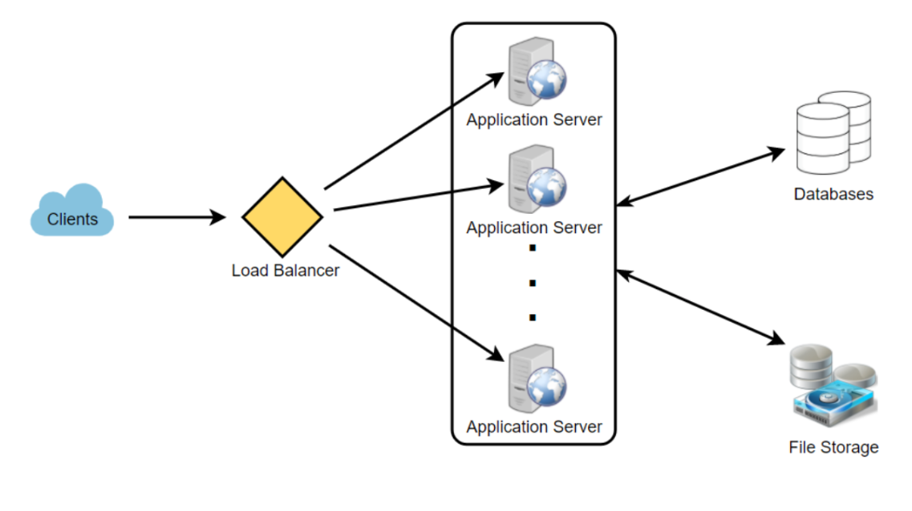
Steps for System Design
High-level Component design
Can’t design an entire system in one go.
Split it into major high-level components and then those into a detailed design based on requirements.
Identify the main components of our system and how they are connected, don’t go into the details yet.
Notes:
Suppose we have application which handles millions of records then we will need a system that can handle all that load while storing efficiently.

Slide 18
Steps for System Design
Detailed design
We want to start by analyzing the different approaches to solving a given problem and the pros/cons of each potential solution.
Do tradeoff analysis at this stage considering :
How much data do we need to cache to speed up the response time?
Where should we need to use load-balancer?
Do w need to partition data to distribute to multiple databases?
Notes:
Now that you have identified your core components, it’s time to dig deeper into them. You want to start by analyzing the different approaches to solving a given problem and the pros/cons of each potential solution.
It’s also important to do tradeoff analysis at this stage. Considerations like these are commonly addressed during this step.
How much data do we need to cache to speed up the response time?
Where should we need to use load-balancer?
Do w need to partition data to distribute to multiple databases?

Slide 19
Steps for System Design
Identify and resolve bottlenecks
Bottlenecks can include anything from traffic, data, storage, availability, redundancy, back-up, etc.
Consider below questions:
Is there a single point of failure in this system? How do we remove it?
Do you have enough data replicas to serve the user in case you lose a few servers?
Do we have enough copies of our services to prevent shutdown?
Notes:
With the detailed design done, the next step is identifying bottlenecks in the system and mitigating them. Bottlenecks can include anything from traffic, data, storage, availability, redundancy, back-up, etc.
Some questions to consider at this stage are:
Is there a single point of failure in this system? How do we remove it?
Do you have enough data replicas to serve the user in case you lose a few servers?
Do we have enough copies of our services to prevent shutdown?

